Slide 1
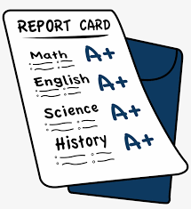
Exam Result Search App
Submitted By-
Babu Chanduval
Kiranmai Emani
Mayank Sonwani
Monik Garg
Saketh Kotakonda
Sangam Thapa

Slide 2
Project Briefing
This application allows students to check their results online using their login credentials and also allows school administration to post the results.
It also manages administrative controls along with standard access to teachers and students for the result related facilities.

Slide 3
Microservice-1 Student Result
This microservice requests student's result by giving student's name as a parameter.
This microservice can access data using the student's credentials only.
For example- If Student1 wants to get the result, he/she can access by their username and password only.

Slide 4
Microservice-2 Result Processor
This microservice allows the administration of school to post, update and delete the result data.
This microservice can manage data by admin credentials only.
For example- If administration of the school wants to manage data he/she can access by their admin login credentials.

Slide 5
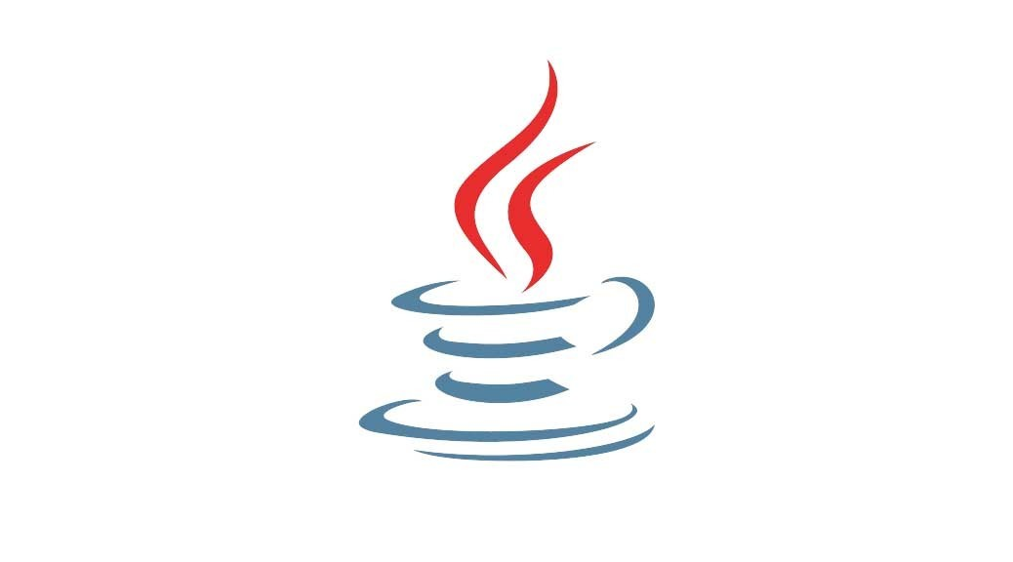



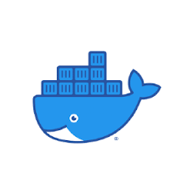
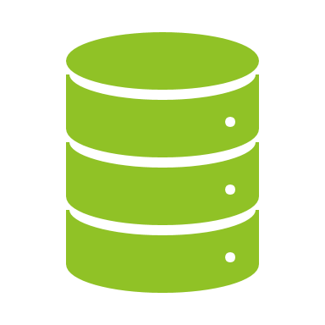

Tools Used
Apache Maven
Docker
Java
Spring Boot
MongoDB
RabbitMQ

Slide 6
Maven is a project management and comprehension tool that provides developers a complete build lifecycle framework. Development team can automate the project's build infrastructure in almost no time as Maven uses a standard directory layout and a default build lifecycle.
In case of multiple development teams environment, Maven can set-up the way to work as per standards in a very short time. As most of the project setups are simple and reusable, Maven makes life of developer easy while creating reports, checks, build and testing automation setups.
Maven provides developers ways to manage the following −
Builds
Documentation
Reporting
Dependencies
SCMs
Releases
Distribution
Mailing list

Slide 7
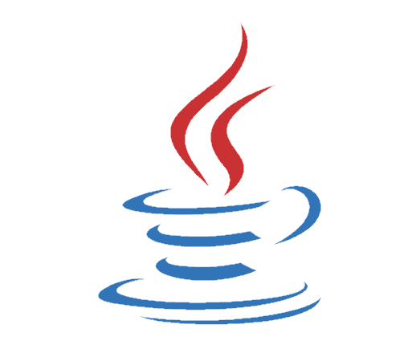
Java
Java is a class-based, object-oriented programming language and is designed to have as few implementation dependencies as possible. A general-purpose programming language made for developers to write once run anywhere that is compiled Java code can run on all platforms that support Java.

Slide 8
Docker
Docker is a software platform that allows you to build, test, and deploy applications quickly. Docker packages software into standardized units called containers that have everything the software needs to run including libraries, system tools, code, and runtime. Using Docker, you can quickly deploy and scale applications into any environment and know your code will run.

Slide 9

What is Spring Boot?
Spring Boot is an open-source Java based framework used to create a micro service. It is developed by Pivotal Team and is used to build stand-alone and production ready spring applications.

Slide 10
Spring Boot Main Components
Spring Boot Starters- combine a group of common or related dependencies into single dependency
Spring Boot AutoConfigurator- reduce the Spring Configuration
Spring Boot CLI- run and test Spring Boot applications from command prompt
Spring Boot Actuator- provides EndPoints and Metrics

Slide 11
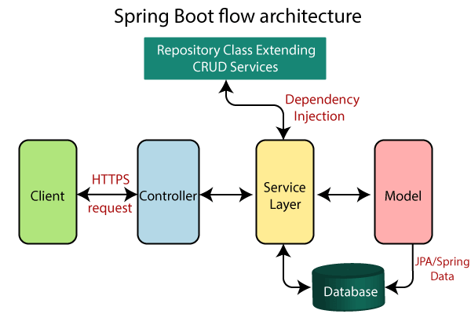

Slide 12
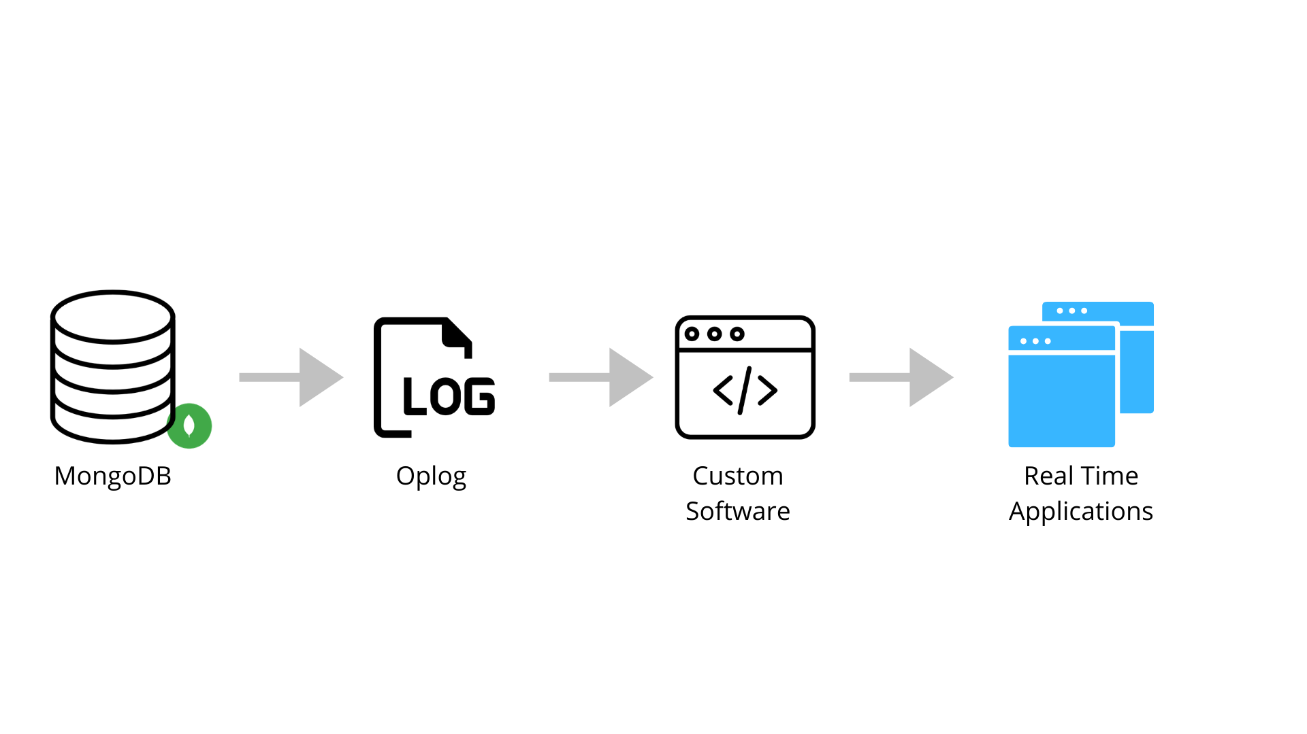
MongoDB
MongoDB is a NoSQL database which stores the data in form of key-value pairs. It is an Open Source, Document Database which provides high performance and scalability along with data modelling and data management of huge sets of data in an enterprise application. MongoDB also provides the feature of Auto-Scaling.

Slide 13
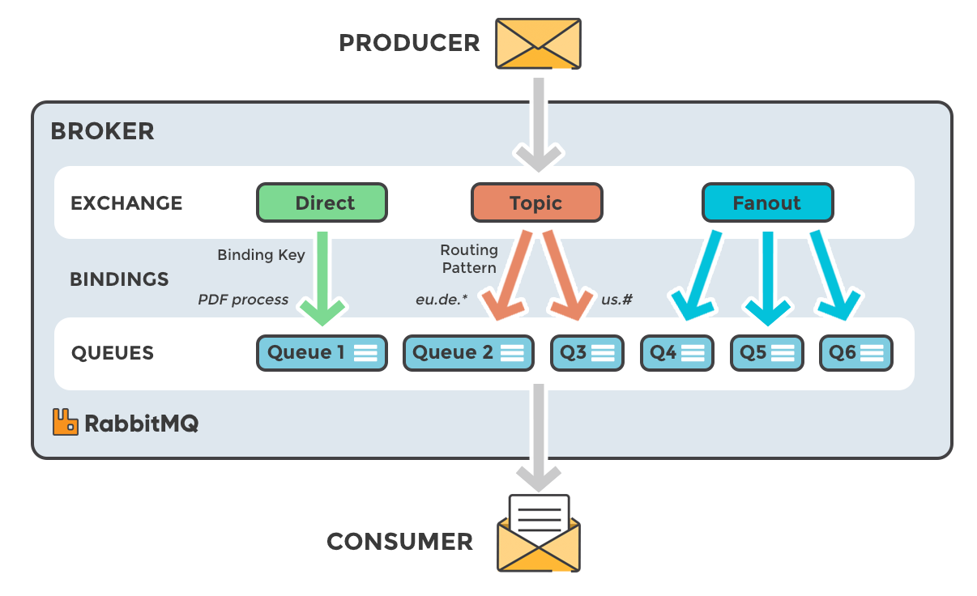
RabbitMQ
RabbitMQ is a messaging broker - an intermediary for messaging. It gives your applications a common platform to send and receive messages, and your messages a safe place to live until received.

Slide 14
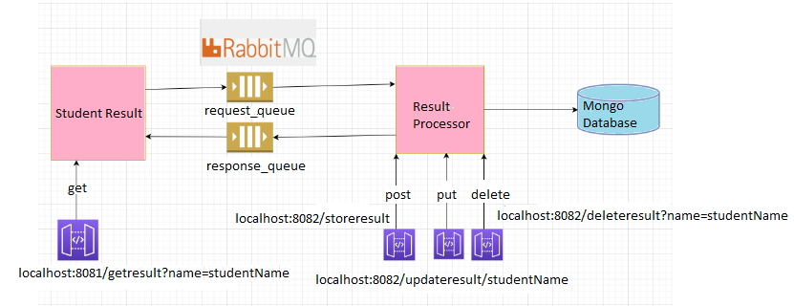
Architecture

Slide 15
Use Cases
This application can be used for accessing and managing result's websites by-
School
College
Government exam
Competitive exams

Slide 16


